Slide 1
Yellow Belt: Lean Workshop 3
Philip Atkinson

Slide 2
Outcomes
Review progress
4 principles, CONQ, MCR, RFT, PA
EE
Process Improvement
Introduce new Concepts and Tools
Brainstorming
Cause Effect
Lean & Stats
Mini Project
Prepare to work on Key Projects
Support for Assignments

Slide 3
Why Process Map?
Records process
Maps what really happens
Gives us the sequence of events
Visual representation
Identifies improvements
Helps staff understand the process

Slide 4
Process Mapping
Map “as is”
Draw Map and define stages
Amend & Change the Map
Identify problems
Categorise Problems
Micro Map Problem areas
Brainstorm
Develop Process Measures, time, quality, cost
Develop Action Plan and Approval
Implement & gain Feedback

Slide 5
Problem Solving
Methodology – Left
Creativity - Right

Slide 6
Tool: Brainstorming
Creative
Powerful
Ideas
Application
Generating Solutions
Problems
Motivates
Working together
Application
Quantity
Rules
One solution & STOP
Fear of looking a Fool
That will not work
Self evaluation

Slide 7
How to Brainstorm
Approach
Well facilitated (dual)
Teamwork
Flexible
Speed of Ideas
Quality
Record
Unorthodox
Rules….some more
Fear of looking a fool
“That will not work – we tried that before”
Every idea is a good idea
Craziest ideas

Slide 8
Brainstorming Exercise
In how many ways can you sell the benefits of Lean working to your colleagues?

Slide 9
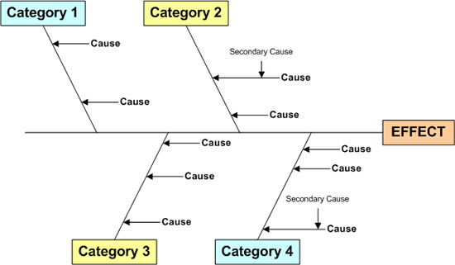
Tool: Fish Bone/Cause Effect

Slide 10
Tool: Fish Bone/Cause Effect

Slide 11
Central Tendency
Describe the key measures of central tendency
In what circumstances would the mean, the median or the mode be the most appropriate measure to use as central tendency in a distribution? What does this tell us about the distribution of data?

Slide 12
Which is most appropriate
Which average is most useful for these sets of data:
22, 26, 31, 24, 23, 27, 46, 22
Red, Blue, Red, Green, Blue, Red, Green, Red
2, 2, 3, 4, 6, 8, 9, 11

Slide 13
Rainfall in Braemar
J | F | M | A | M | J | J | A | S | O | N | D
93 | 59 | 59 | 51 | 65 | 55 | 58 | 76 | 73 | 87 | 86 | 96

Slide 14
Dispersion Of Data
Describe the key measures of central tendency
In what circumstances would the mean, the median or the mode be the most appropriate measure to use as central tendency in a distribution? What does this tell us about the distribution of data?

Slide 15
Statistical Techniques
How can you use statistical techniques to support you in using DMAIC as a Lean methodology for change?

Slide 16
Lean Six Sigma
Lean
Eradicating 8 Wastes
Transport
Inventory
Motion
Waiting
Over processing
Over production
Defects
Staff - Unused creativity
Speed up Delivery
Refine processes
Error proofing - ZD
Six Sigma - DPMO
1, 68%
2, 95%
3, 98.97%
4, 99.4%
5, 99.98%
6, 99.99966%

Slide 17
Use of Statistics
Data is random and neutral
Gives meaning
Capturing data vs. ignorance
Creating baseline data
Question assumptions and myths
Separate causes from symptoms
Review scale of problem
Scopes problems
Variation from expected
Focus on required rather than available data
Quantitative and Qualitative
Qualitative techniques
M&D
Notes:
Capturing data vs. ignorance
Creating baseline data
Question assumptions and myths
Separate causes from symptoms
Review scale of problem

Slide 18
Statistical Applications
Take poor quality of service issues seriously
Shape the corporate culture
Develop managers in Lean and CI
Negotiate service level agreements between departments
Assess efficiency, effectiveness and productivity at every level
Tackle waste and rework in customer facing processes
Deal with customer enquiries and complaints
Redesign the customer pathway
Analyse and evaluate uncertificated absence from work
Take action about poor performance in the supply chain
Improve the attendance rate at training events
Train people in customer service at every level
Research new service delivery/digital
Inability to respond quickly to stakeholder/regulatory demands
Evaluate performance

Slide 19
Mini Project
1. Define
What is the project you would tackle and how would you rate the problems currently that need rectified?
Have you scoped out the project to your satisfaction?
There are probably a number of people who would benefit from the improvement – please identify people as key stakeholders or service users and describe the benefits they may gain when the problem is resolved.

Slide 20
Mini Project
2. Measure
What are the symptoms of the larger problems and how do these create inefficiencies?
Given the choice, what data or information would you want to start collecting so you can analyse the problem?
Suggest how you could record the data and show it visually. Give examples of how you would display this in graphical format

Slide 21
Mini Project
3. Analyse
Using fishbone diagrams – what are the major causes of the problems?
Identify the key issues that you would ideally like to explore in some depth

Slide 22
Mini Project
4. Improve
Just suppose that you had completed the analysis – what things would need to be undertaken to remove the major cause of the problem so that things worked more effectively and you cut down on waste?
What specific actions do you think you would have to take?

Slide 23
Mini Project
5. Control
If you had to monitor performance, what sort of things would you start to measure?
What needs to be done to ensure that you can spot when things are going wrong?

Slide 24
Summary
Brainstorming
Cause Effect Analysis
Lean & Stats
Mini Project

